Slide 1
Extended Project Qualification
By Louie Jones-Strong
UTC @ harbourside
2017

Slide 2
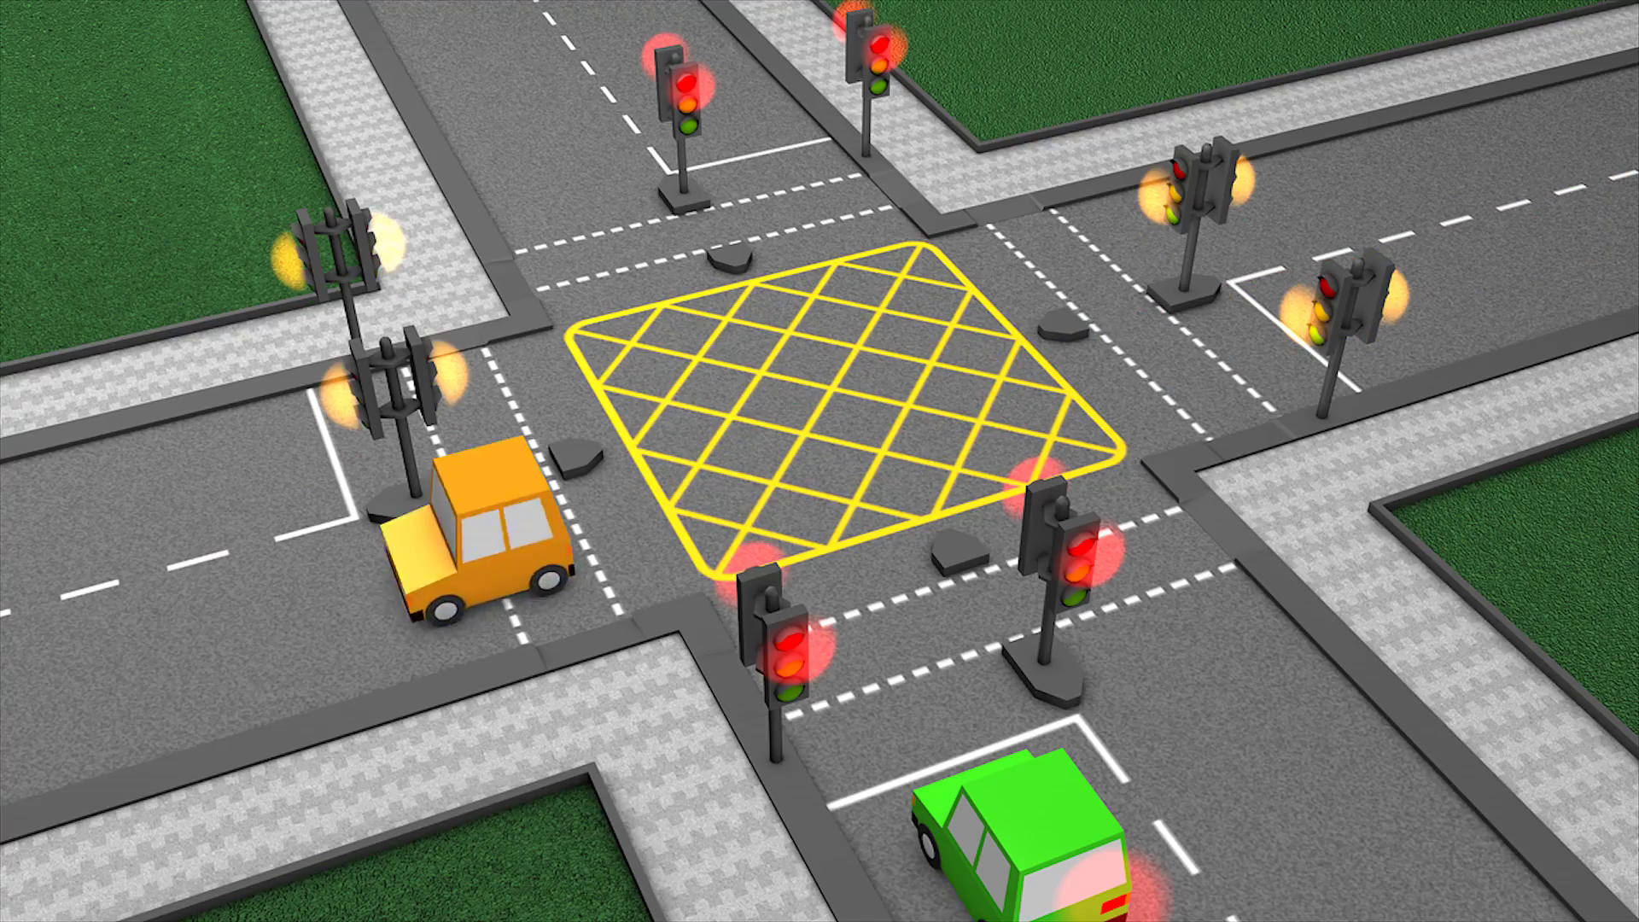
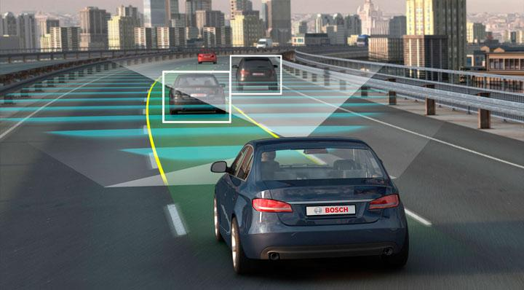
What is
Artificial Intelligence?
AI stands for artificial intelligence.
AI is split into two different types: hard coded and machine learning. an example of a hardcoded AI is traffic lights as they are on a timer until someone presses the button to cross.
An example of a machine learning is self driving cars as they teach themselves how to drive based on human models of good driving.
Notes:
Hardcode, machine learning

Slide 3

What is my product?
My EPQ is to make a program that can test and run different machine learning AI that I have coded. This will be used to investigate a hypothesis.
The AI I have coded:
Brute force
Neural networking
Evolution
Combined
random
Notes:
Neural networking and evolution

Slide 4

Brute force
This is the simplest version of machine learning
Has to have data on every possible board
Outputs a dataset
Slow
Can’t predict
Difficult to implement once learned

Slide 5
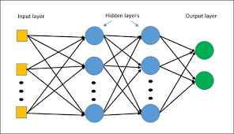
Neural network
Neural networks are a mathematical model based on the human brain. Designed by Alan Turing .
Needs a dataset as input
Outputs network
Fast
Can make predictions
Easy to implement once learned

Slide 6
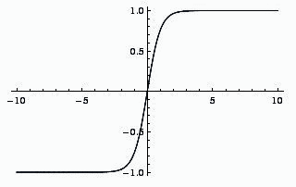
Neural network
Htan
Bias
Bias
Inputs
Hidden
Outputs
Errors
back propagation

Slide 7
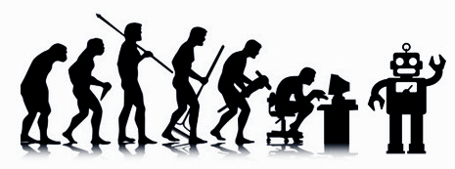
Evolution
Seed
Based on darwin's model of evolution
Input random or trained network
Outputs network
Slow
Can make predictions
Easy to implement once learned
split
rank
select
breed
1
2
3
1
4
2

Slide 8
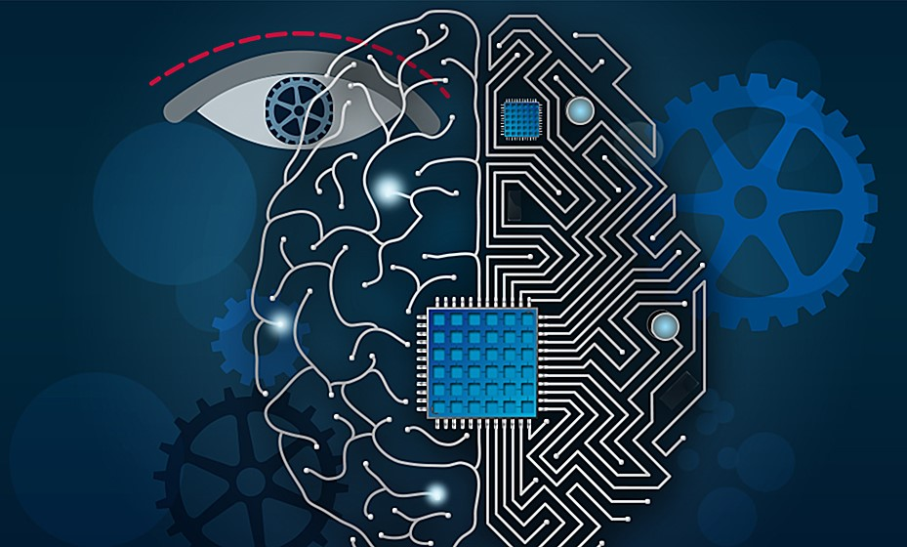
Combined
How it works:
Brute force to learn a dataset or human playing each other
Neural Network to learn the dataset
Evolution to improve the last part to make it better on the unplayed boards
Theoretically should:
Be faster
More accurate
Able Learn to more tasks

Slide 9
Hypothesis
An AI that uses a combination of multiple learning techniques, is better than an AI that uses only one learning technique

Slide 10
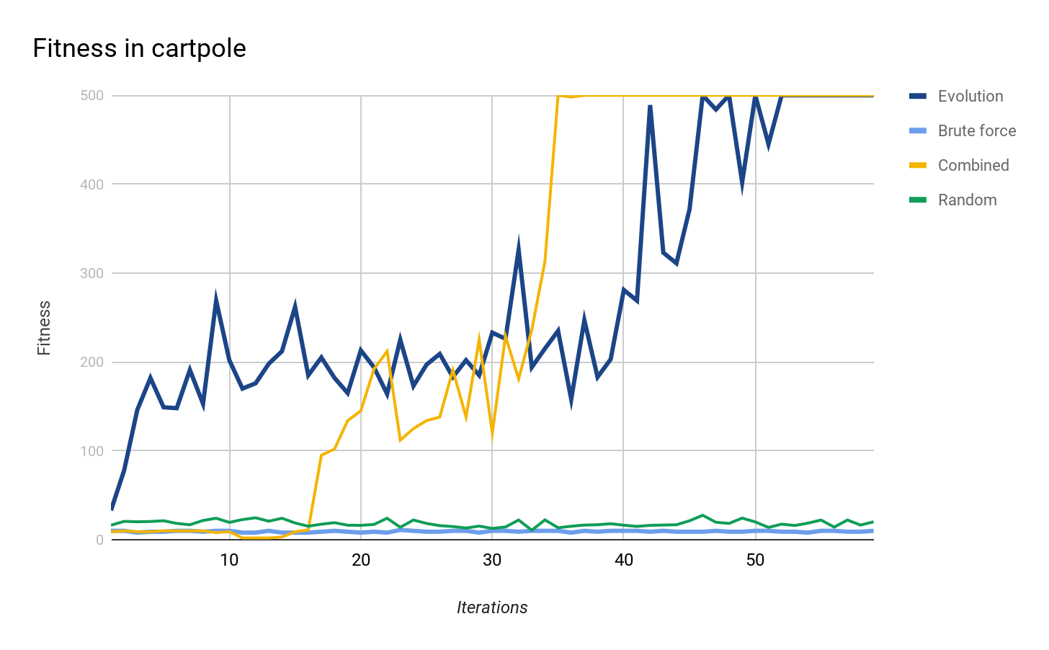

Results
Worst best
Environment from OpenAI gym:

Slide 11
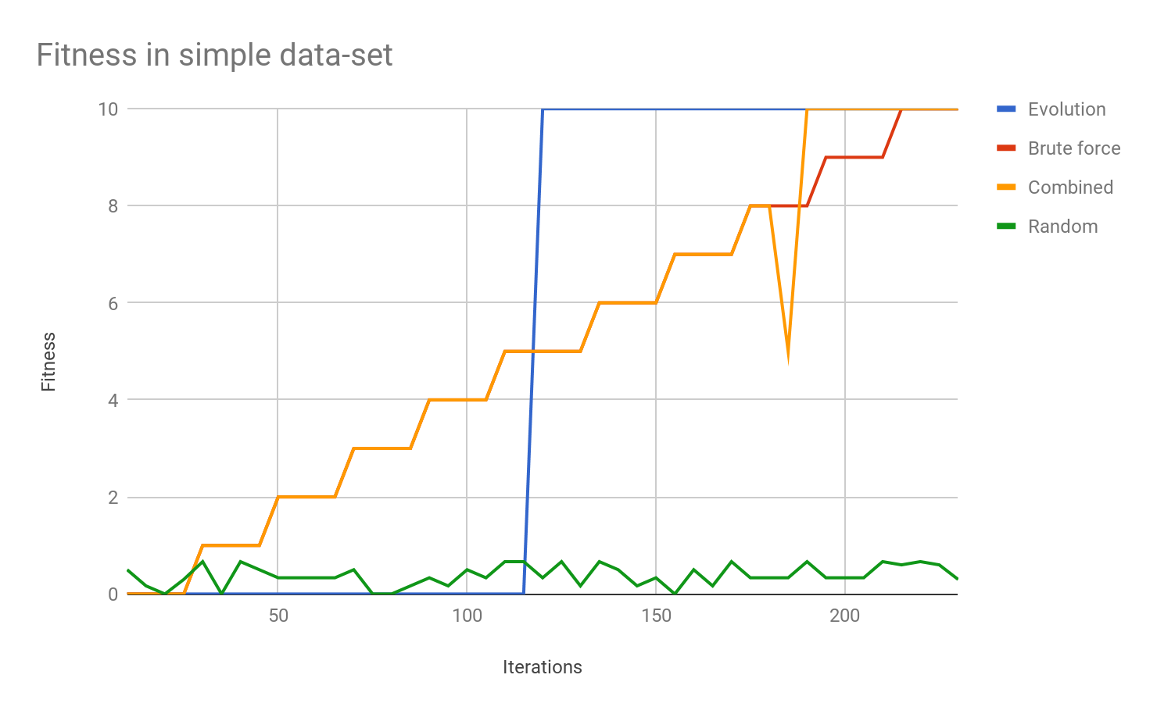
Results

Slide 12
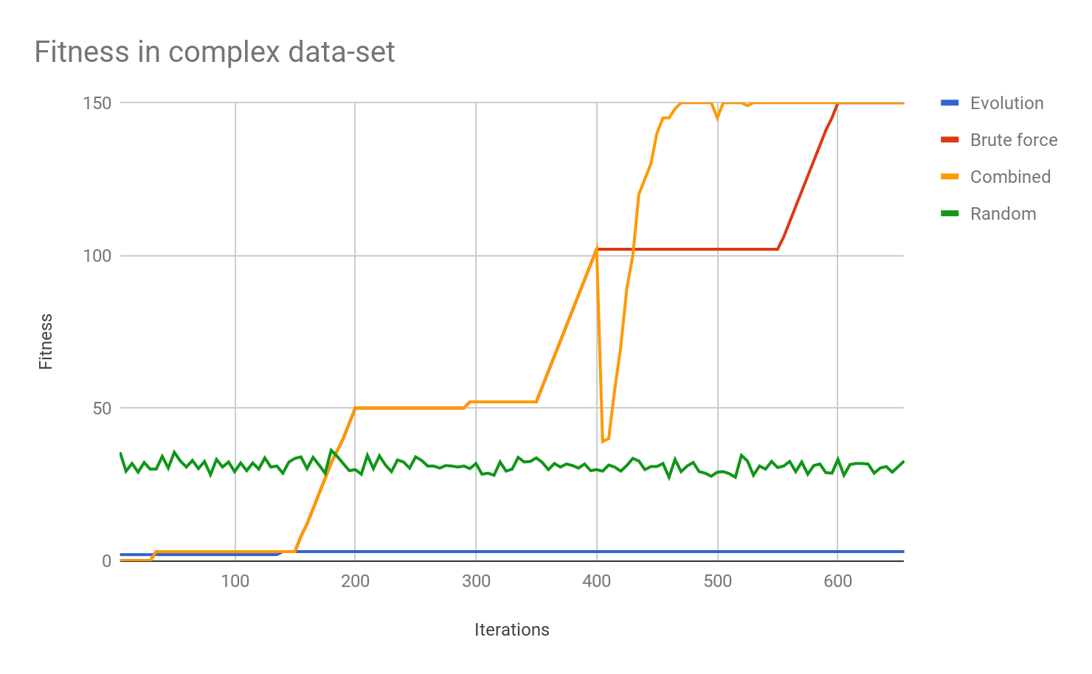
Results

Slide 13
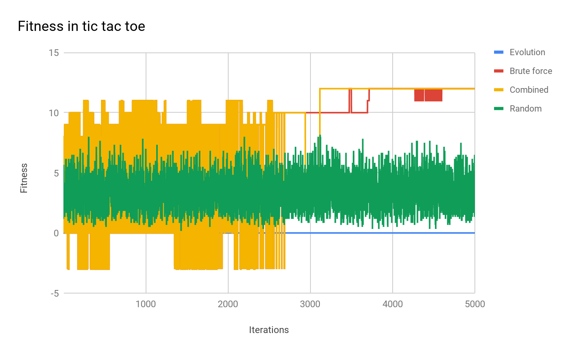
Results

Slide 14
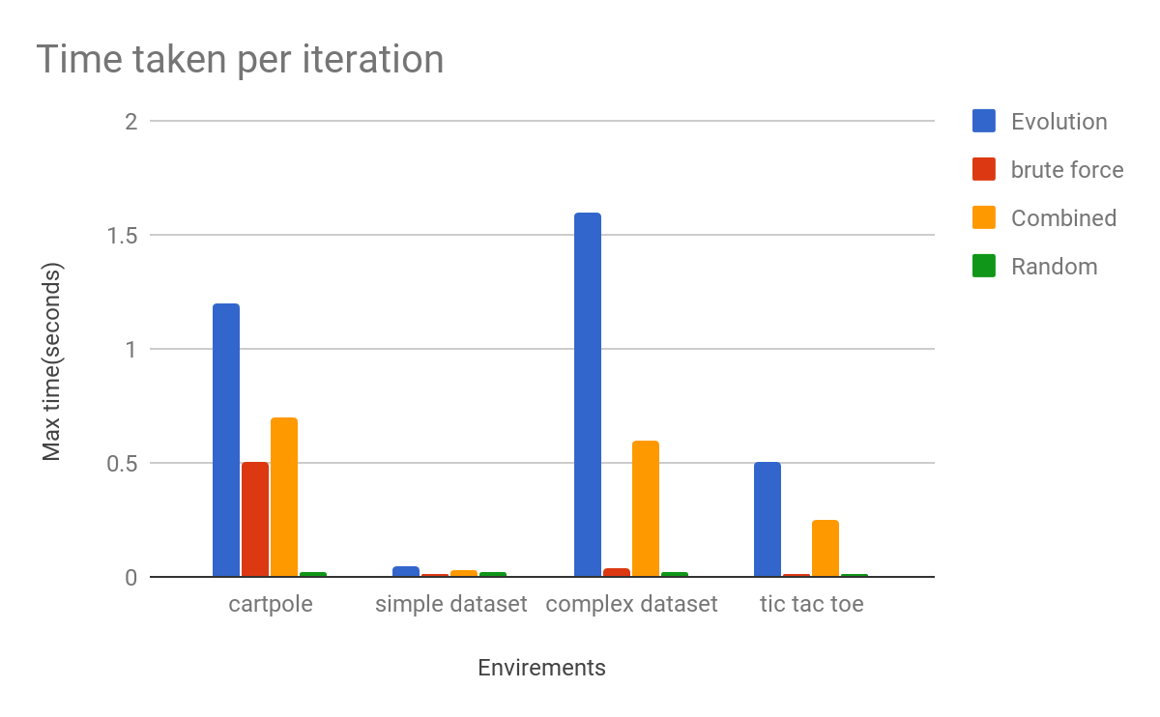
Results
 | Evolution | Brute force | Combined | Random
cartpole | 1.2 | 0.5 | 0.7 | 0.02
simple dataset | 0.05 | 0.01 | 0.03 | 0.02
complex dataset | 1.6 | 0.04 | 0.6 | 0.02
tic tac toe | 0.5 | 0.01 | 0.25 | 0.01

Slide 15
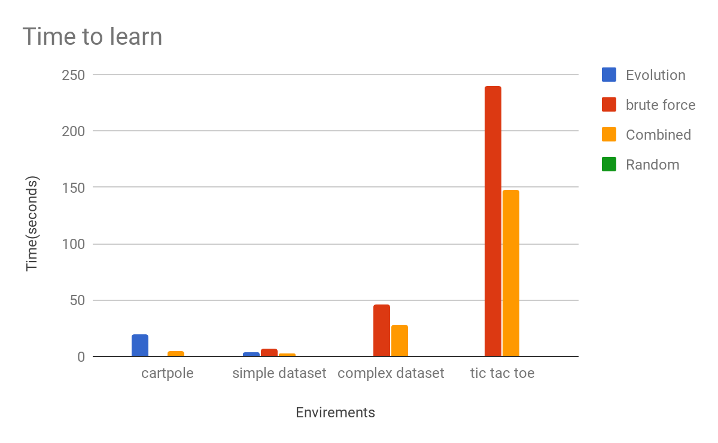
Results
 | Evolution | Brute force | Combined | Random
cartpole | 20 | N/A | 5 | N/A
simple dataset | 3.5 | 6.5 | 2.5 | N/A
complex dataset | N/A | 46 | 28 | N/A
tic tac toe | N/A | 240 | 150 | N/A

Slide 16
Conclusion
I can prove my hypothesis is correct from these results!
Combined AI is:
faster
more accurate
more reliable
Suited to more environments

Slide 17
Evaluation of product
In evaluation I feel my product has meet most of the criteria that I set out apart from the fact that the neural network can’t run this is due to the way they work that i didn’t understand at the start of the project
To make a code to run AI
To code brute force
To code neural network
To code evolution
To code a selection of different environments
To use this to make a paper

Slide 18
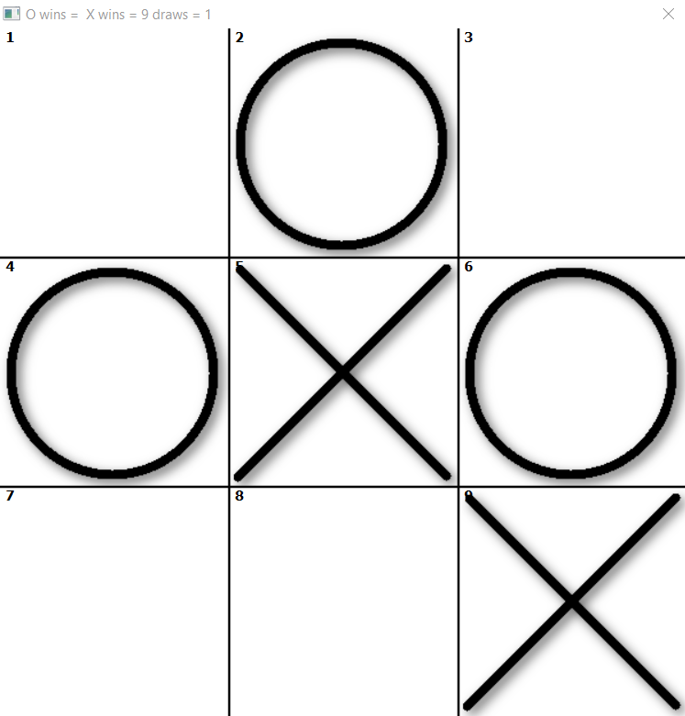
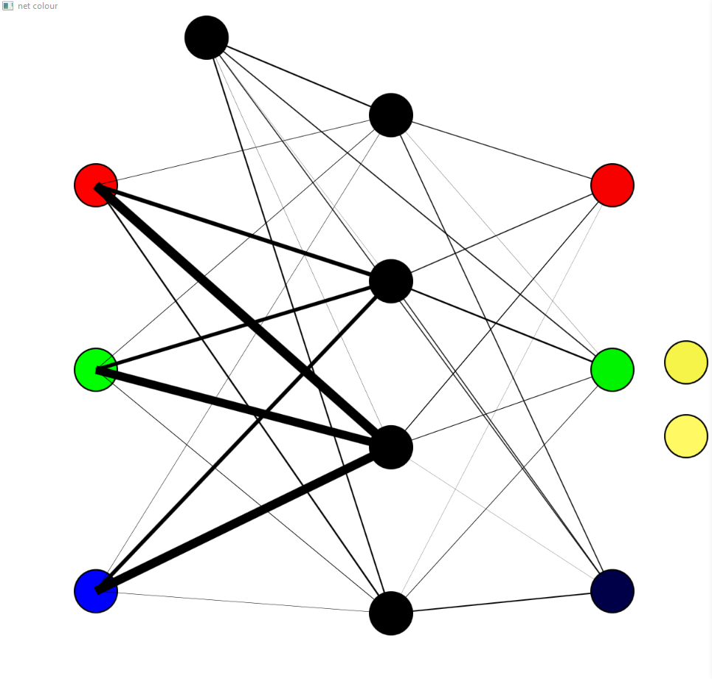
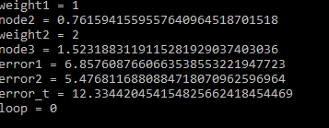
How my product as changed
Went from just making a product to fixing a problem in the field of machine learning.
All coded in small basic
Called: 3 nodes v3
Testing out how to make a better network
Called: learning 2.0
Would take 2:30 hours to learn tic tac toe
Called: learning
Would take 2-5 days to learn tic tac toe
Called: colour net
Would take 30 seconds
To learn how to make colours

Slide 19
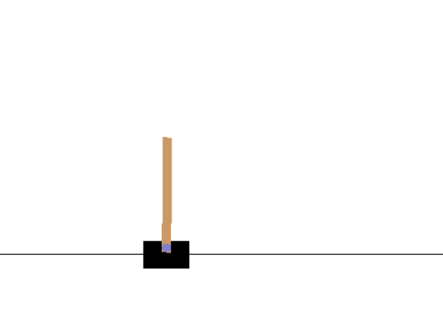
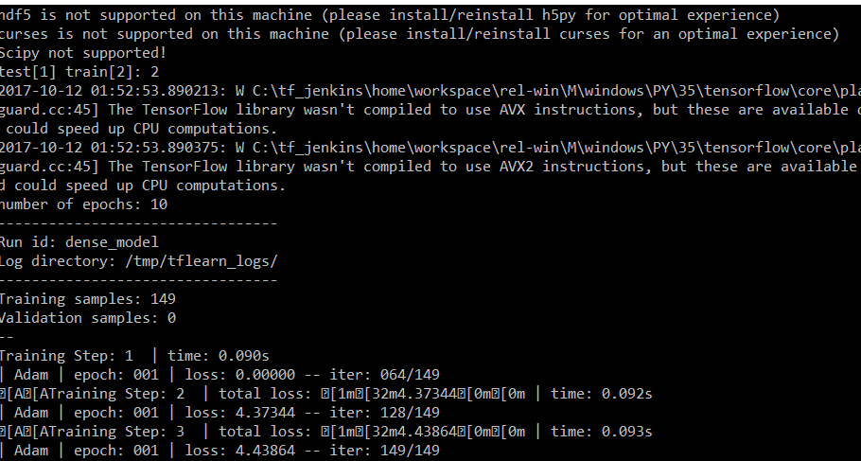
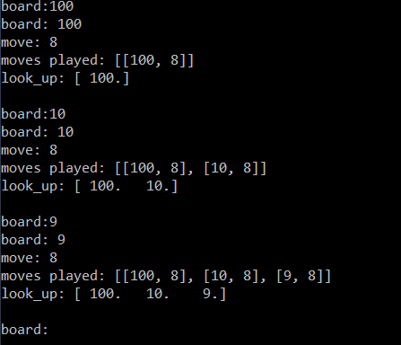
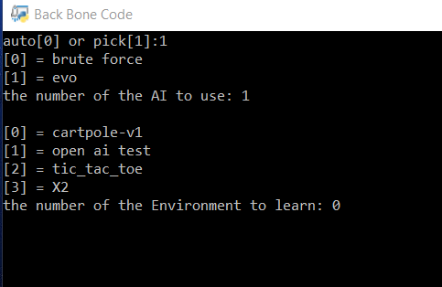
How my product as changed
Over 70,000 lines of code
Over 150 files
10GB of learned data
All coded in python
Called: Brute Force py
Test code for brute force
And to learn python
Called: back bone code
Prototype
Can learn tic tac toe in 4 minutes
Called: neural network
Can learn iris dataset in 1 minute
Called: full AI 2.0
Finished EPQ
Can now learn tic tac toe
In 2:30 minutes

Slide 20
How I am going to continue this project
Add the ability to learn from human skills
Make it faster and more efficient
Add visual input
Make combined teach itself the best structure for each problem
Add new environments
Implement into the real world
Try to Implement into a self driving car

Slide 21
Thank you for listening

